Slide 1




Connect 4: Robot Autonomous Player
Graduation Presentation
Boris Ivanov

Slide 2
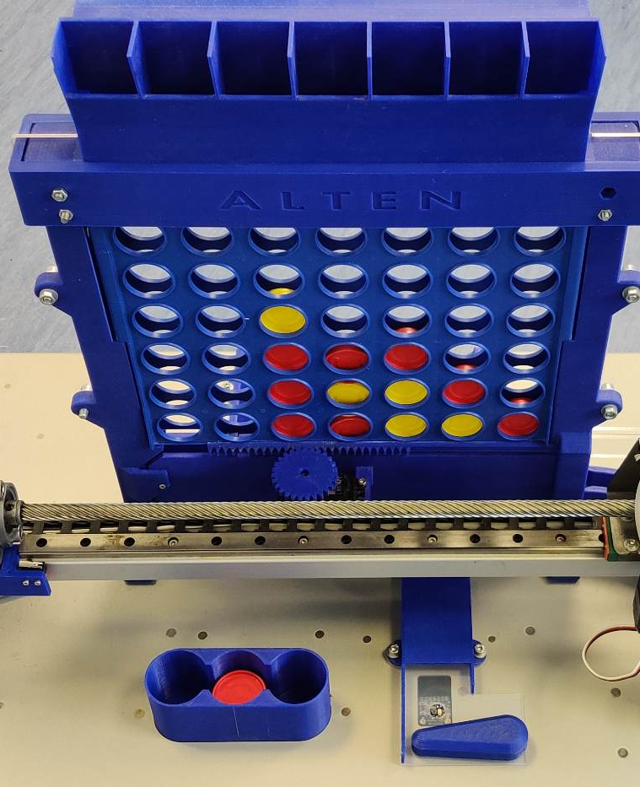
Introduction
Notes:
Good afternoon everyone, my name is Boris Ivanov and I'm delighted to be here today. I'm a 25-year-old electrical and electronic engineering student at Fontys, originally from the beautiful city of Varna, Bulgaria. Currently, I'm working on an exciting project called Connect-4 robot for ALTEN. It's a fascinating project that involves programming a robot to play the classic game Connect-4. As an engineer, I'm passionate about solving problems and creating solutions, and this project is a great opportunity for me to hone my skills. I look forward to sharing more about my work with you all.

Slide 3
Table Of Content
Introduction to the company
Introduction to the Connect-4 Game
The project and my task
The research
The design
Software implementation and testing
Video
Conclusions and recommendations
Questions

Slide 4
ALTEN
ALTEN is a global technology consulting and engineering firm .
As a consultancy, ALTEN works with a wide variety of clients allowing their consultants to work on an area of engineering where their knowledge would be best applied.
Their expertise within the Netherlands lies in ALTEN IT, Technical Software, and Mechatronics and others.
Notes:
ALTEN provides research projects for technical and information systems divisions in various sectors, such as industrial, telecommunications, and service.

Slide 5
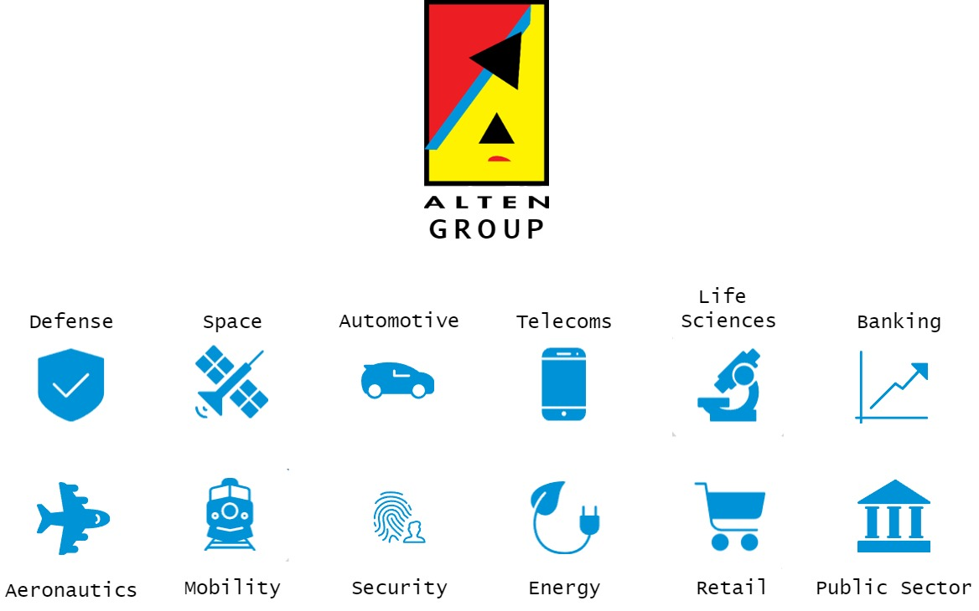

Slide 6
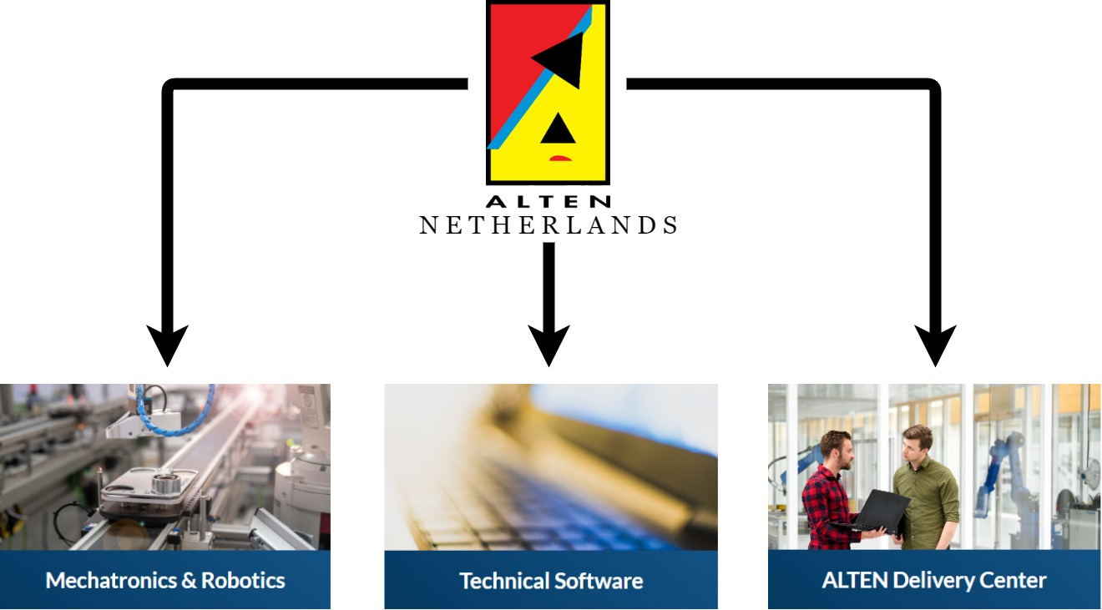
Notes:
Technical software focuses on embedded systems, simulation & modelling, monitoring & control, and business critical systems. This includes anything from banking systems to traffic light control.
ALTEN's mechatronics services include designing and prototyping complex systems, simulation and modelling, control systems development, system integration, and testing and validation.
The connect-4 robot falls somewhere in between TS and MTR.

Slide 7
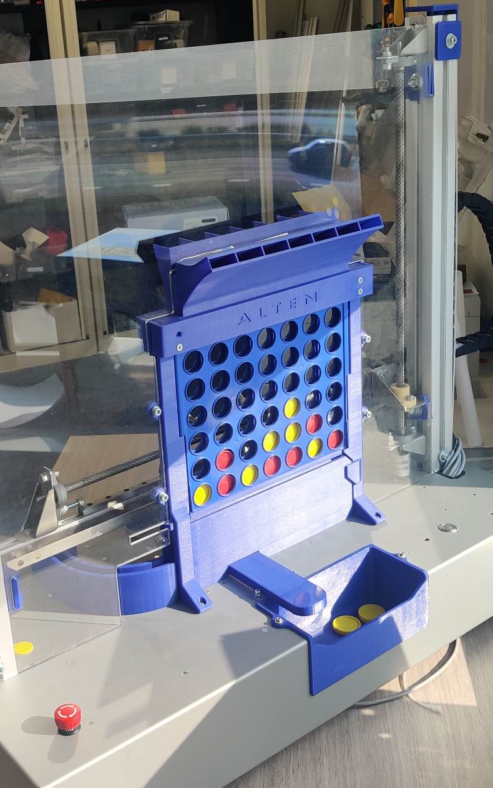
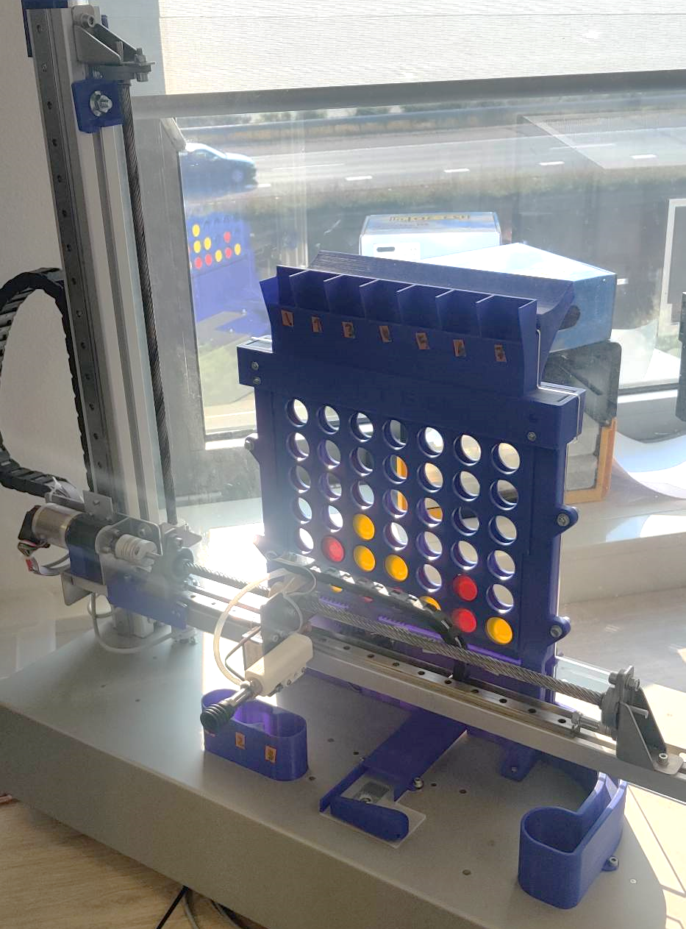
The Connect-4 Game
Notes:
[BRIEF INTRODUCTION OF THE GAME RULES]
[BRIEF INTRODUCTION OF ROBOT PARTS]

Slide 8

The Connect 4 Machine - Intention
8
The robot is designed to provide a fun experience for players, while showcasing the potential of robotics and technology in interactive applications.
The machine's design aims to display ALTEN's expertise at events like showroom floors and open days.
Notes:
1. the Cortex-M4 controls motors and sensors, while the Cortex-M7 manages game strategy and player communication.
2. Slide
At the heart of the Connect 4 Robot is a microcontroller (small computer), with two cores. They are working together to control the robot's movements and game logic. One core, called the Cortex-M4, is responsible for managing the robot's motors and sensors, while the other, the Cortex-M7, handles higher-level tasks like game strategy and communication with the human player.
HSEMs help prevent conflicts and ensure that the microcontrollers share information effectively.

Slide 9
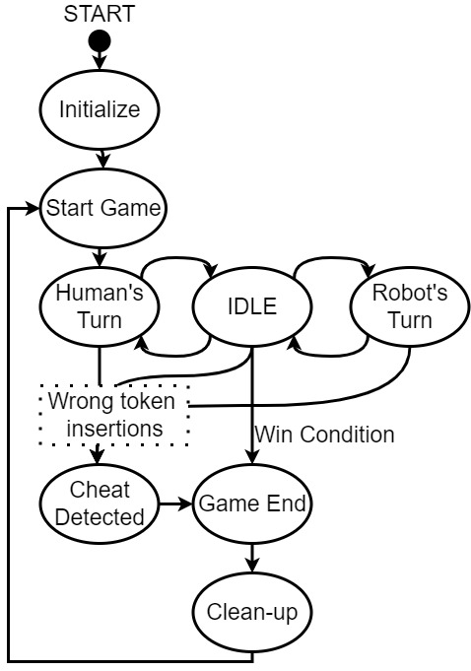
The Connect-4 Machine

Slide 10
The Connect-4 Machine
A microcontroller that has two cores working together.
Synchronization is achieved through a synchronization primitive called a Semaphore
The Cortex-M7 controls the higher-level logic and Cortex-M4
Cortex-M4 controls all the low-level logic.
Like movement of motors and sensors.
Notes:
1. the Cortex-M4 controls motors and sensors, while the Cortex-M7 manages game strategy and player communication.
The robot is designed to provide a fun and challenging experience for players while showcasing the potential of robotics and microcontroller technology in interactive applications.
The reasoning for the design of the machine being, to have something that can be used to show ALTEN’s expertise to showroom floors, open days and such events.
2. Slide
At the heart of the Connect 4 Robot is a microcontroller (small computer), with two cores. They are working together to control the robot's movements and game logic. One core, called the Cortex-M4, is responsible for managing the robot's motors and sensors, while the other, the Cortex-M7, handles higher-level tasks like game strategy and communication with the human player.
HSEMs help prevent conflicts and ensure that the microcontrollers share information effectively.

Slide 11
The Initial State of the Project
11
Before my involvement, the system had all the hardware components in place and a software design that worked on the single-core implementation from several years ago.
1
2
3
4
5
Notes:
After further development of the old system, it was clear that a more powerful controller was needed to facilitate the new additions that ALTEN wanted to add to the system.
A dual-core microcontroller, which can handle the requirements of the system. (Integrate game_decision in CM7, LCD screen, Cloud/Ethernet)

Slide 12
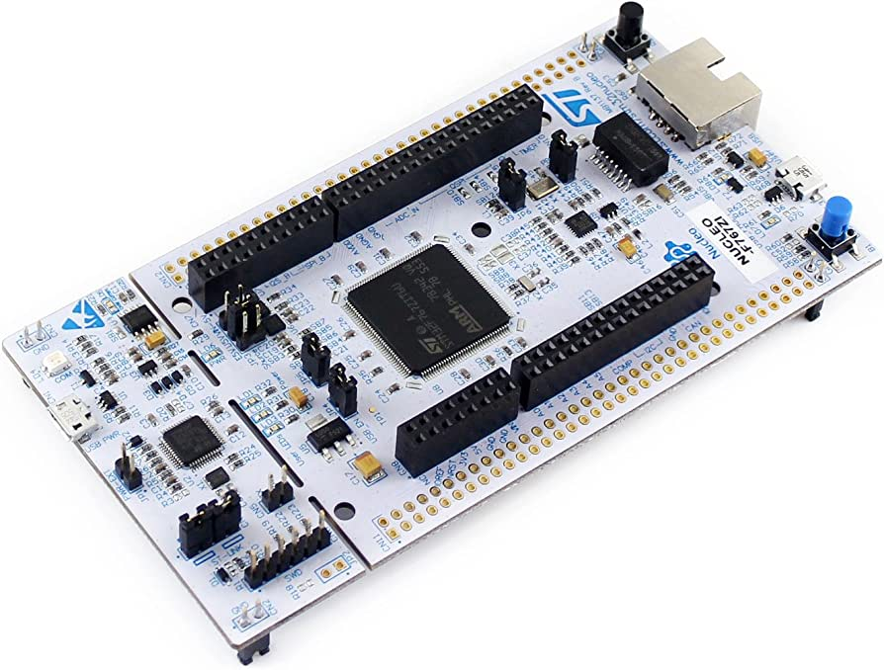
The Initial State of the Project
12
1
2
3
4
5
A new controller was chosen in the face of STM32H755.
Notes:
After further development of the old system, it was clear that a more powerful controller was needed to facilitate the new additions that ALTEN wanted to add to the system.
A dual-core microcontroller, which can handle the requirements of the system. (Integrate game_decision in CM7, LCD screen, Cloud/Ethernet)

Slide 13
The Initial State of the Project
13
1
2
3
4
5
A new software architecture was designed
Notes:
After further development of the old system, it was clear that a more powerful controller was needed to facilitate the new additions that ALTEN wanted to add to the system.
A dual-core microcontroller, which can handle the requirements of the system. (Integrate game_decision in CM7, LCD screen, Cloud/Ethernet)

Slide 14
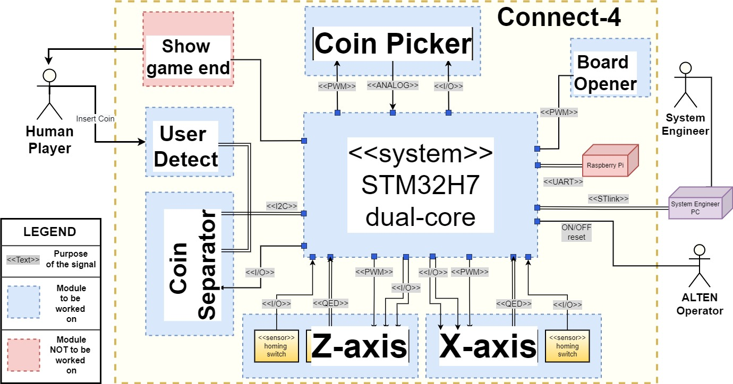
The Initial State of the Project
1
2
3
4
5
14
Notes:
After further development of the old system, it was clear that a more powerful controller was needed to facilitate the new additions that ALTEN wanted to add to the system.
A dual-core microcontroller, which can handle the requirements of the system. (Integrate game_decision in CM7, LCD screen, Cloud/Ethernet)

Slide 15
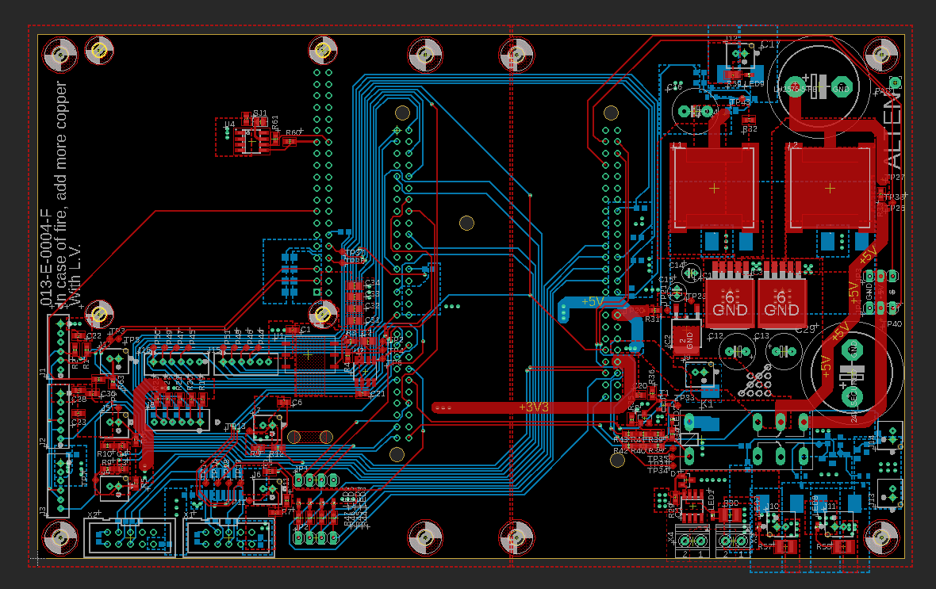
The Initial State of the Project
15
1
2
3
4
5
A new PCB to facilitate the new controller was also designed
Notes:
After further development of the old system, it was clear that a more powerful controller was needed to facilitate the new additions that ALTEN wanted to add to the system.
A dual-core microcontroller, which can handle the requirements of the system. (Integrate game_decision in CM7, LCD screen, Cloud/Ethernet)

Slide 16
The Initial State of the Project
16
1
2
3
4
5
Both previous designs included some software projects, but only for demonstration purposes.
The “Legacy Project”, the initial working version from the old STM32F.
The “Connect-4 Demo.
The “Dual-Core Communication Demo”.
The “Initialization Demo”.
Notes:
After further development of the old system, it was clear that a more powerful controller was needed to facilitate the new additions that ALTEN wanted to add to the system.
A dual-core microcontroller, which can handle the requirements of the system. (Integrate game_decision in CM7, LCD screen, Cloud/Ethernet)
Connect-4 Demo, which has code for the Task Generator based on Figure 9: Send-Event Instruction notification mechanism [7] through HSEM (Hardware Semaphores) and the basic FSM on the game logic described in the software architecture design
The “Dual-Core Communication Demo”

Slide 17
My task
1
2
3
4
17
The legacy code needs to be adapted and optimized for the new microcontroller.

Slide 18
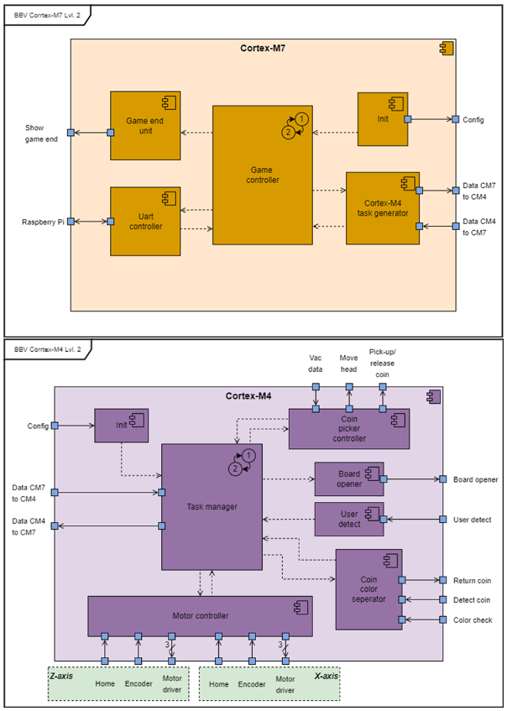
My task
1
2
3
4
18
Notes:
All of the legacy code could be encapsulated by CM4, as it was on that core that it was running previously.

Slide 19
My task
1
2
3
4
19
The legacy code needs to be adapted and optimized for the new microcontroller.
Further development of the state machines that control the logic of the cores.

Slide 20
My task
1
2
3
4
20

Slide 21
My task
1
2
3
4
21

Slide 22
My task
1
2
3
4
22
The legacy code needs to be adapted and optimized for the new microcontroller.
Further development of the state machines that control the logic of the cores.
Set up the software so it adheres to the new architecture.

Slide 23
My task
1
2
3
4
23
The legacy code needs to be adapted and optimized for the new microcontroller.
Further development of the state machines that control the logic of the cores.
Set up the software so it adheres to the new architecture.
Evaluate the architecture and software code designed so far.

Slide 24
Research
24
Mapping legacy code to new architecture
Improve the FSM of the Game Controller and Task Manager
How to evaluate the system
What to test
How to test it
Notes:
Unit tests for the lowest level peripherals – Such as TIMers, NVIC_NestedVectorInterrupt, UART, I2C, ETH. Necessary in order to build confidence that the lowest level of hardware is functioning correctly.
Functionality tests, that provide confidence in the lowest blocks (one from level 3 in the architecture).
Then functionality tests about level 2 and level 1 were made. A lot of the overlap in criteria they test, however for a thorough and complete testing each level has to pass these test, so it can be ensured that everything on all levels of the architecture behaves as expected. That baseline of expectations has to be set somewhere, and the test created are precisely that.

Slide 25
Design
25
To be improved
Motor X
Motor Z
PID X
PID Z
Motor Master
Encoder
Home-Switch
Motor Driver
Solenoid
Token Separator Master
Servo Controller
Vacuum Pump
Task Manager
Game Controller
Task Generator
UART controller
To be designed
Colour Sensor
Proxy Sensor
Servo Controller
Token Picker Master
User Detector
Board Opener
Init-CM4
Init-CM7
Game end unit

Slide 26
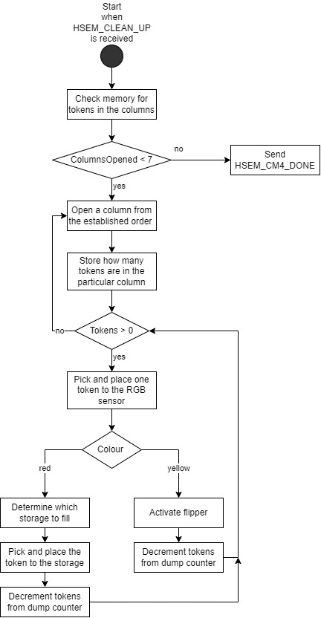
Design
26

Slide 27
Combined overview of the higher-logic of the system

Slide 28
Software Testing
28
Unit Testing
Module Testing
Functionality Testing
Best/Worst Case Testing
Notes:
Timing can be recorded. Acceptance tests exist as well.

Slide 29
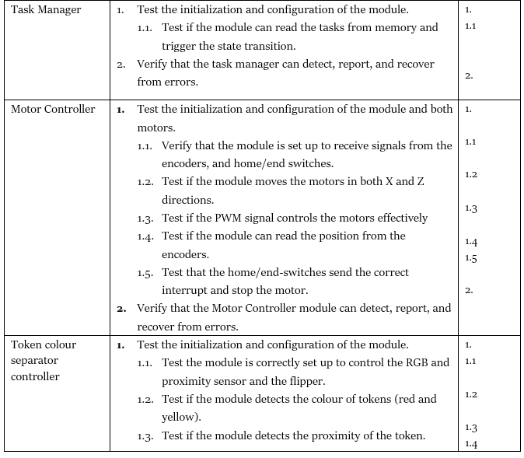
Software Testing
29
Notes:
Timing can be recorded. Acceptance tests exist as well.

Slide 30
Video

Slide 31
Conclusions
Initially the robot wasn’t functioning as a unit → Through my work now it does.
In terms of the architecture, Levels 2 and 3 are implemented in the system but not to their full extent.
Level 1 to be done.
The architecture designed is functioning well, however some parts of it were ambiguous, and needed further clarification/designing.

Slide 32
Recommendations
There’s a lot of room for improvement in the software:
Implementing the full functionality of the modules.
Implementing PID controllers in the Motor Controller.
Various TODO tasks that I’ve left in the code base.
Some mechanical changes have to be made:
Fixture for the cable on Z-axis.
Light-gate has a wall that is broken.
And some electrical changes as well:
Some connectors pop out their cables really easily.
Several MOSFETs burned due to having been wired wrongly.

Slide 33

Thank you for your attention!
Questions ?

Slide 34
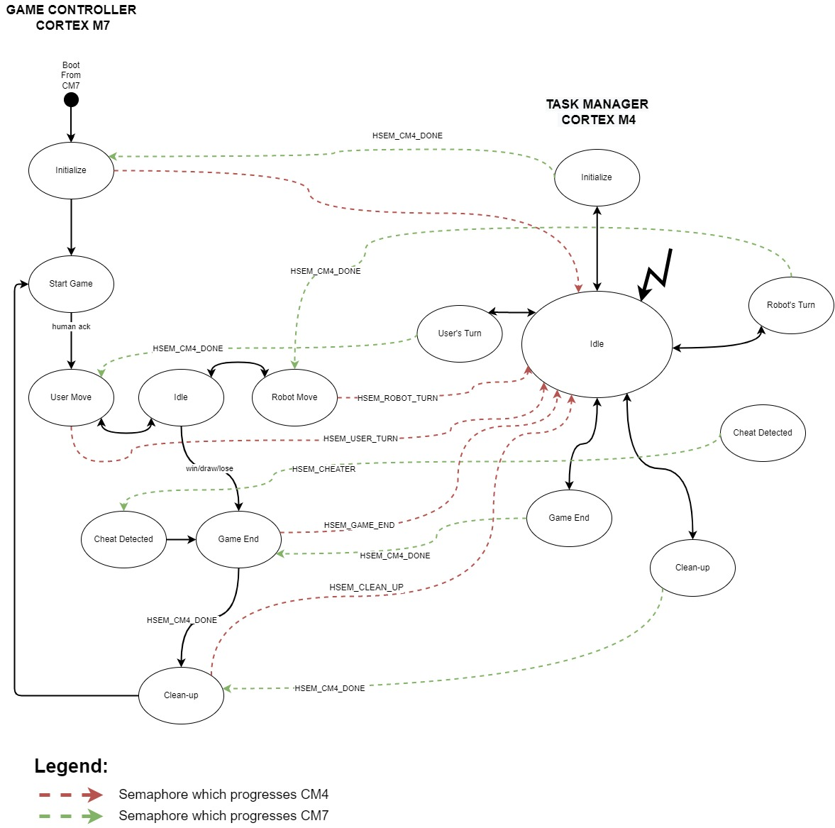
Notes:
The Semaphores in the code are used to signal to each core when it should transition states, in order to advance further. In any given core, we activate notifications for semaphores for which we would require a reaction when released. In the other core, we take and release the semaphore, to trigger the response in the first core. This response in our case is triggering a state transition, by giving it a "task". One semaphore is one task. By releasing a specific semaphore in a certain state, specific actions need to happen. By using the semaphores in such a way, we can make the two cores, synchronize their tasks and advance each other accordingly.

Slide 35
Код на снимки

Slide 36
HSEM Diagram NVIC

